Slide 1

Exploring Research Areas & Pathways

Slide 2
Agenda
1
2
3
4
Research
REUs
Career Interests
Blood Research

Slide 3
Research programs

Slide 4
How to get involved in research?
Universities
State funded
Programs
.
Government sponsored
Local Chapters
&
Health Science Clubs
Private Research
Networking , Cold Emails,
Volunteering

Slide 5
Where to Look?
High-school programs
City/County/State Funded Programs
Professors/ Research Faculties at Universities
Local Chapters/Programs
Hospitals, Healthcare facilities, Research Labs
Mentors/Seniors

Slide 6
How to get involved in research?
Universities
State funded
Programs
.
Government sponsored
Local Chapters
&
Health Science Clubs
Private Research
Networking , Cold Emails,
Volunteering

Slide 7

Research Experiences for undergrads
An REU Site typically involves a group of around 10 students who work on related research projects at a host institution based in the United States or sometimes at an international location.
At each REU Site, students work closely with faculty and other senior researchers to:
Conduct authentic research.
Receive mentoring.
Build their knowledge and research skills.
Learn about educational and career pathways in STEM.
Search REU Sites | NSF - National Science Foundation

Slide 8

Pathways to Science
The mission of the Institute for Broadening Participation is to increase diversity in the Science, Technology, Engineering and Mathematics (STEM) workforce
Since 2003, IBP has connected underrepresented students with STEM funding and research opportunities
STEM Internships, Camps & Funding Opportunities (K-12 level)

Slide 9
REU Finder
Online resource
REU Finder - Resources For STEM Undergrads

Slide 10
Nursing

Slide 11
Opportunities
The Seacole Scholars Program
Kaiser Permanente (KP) Launch High School Program
Eve and Gene Black Summer Medical Career Program
Summer Health Institute for Nursing Exploration and Success (SHINES) at UC Davis
Summer Nurse Camp at Seattle Children’s Hospital
University of Washington Nurse Camp
High School Nurse Camp at the University of Portland
Nurse Camp at CompassRN
Lumiere Research Scholar Programs*

Slide 12
Opportunities
Summer Child Health Research Internship by the University of Colorado School of Medicine and Children’s Hospital Colorado
The Johns Hopkins Internship in Brain Science Program (JHIBS): Project Pipeline Baltimore
Cleveland Clinic Summer Internship Program
Mayo Clinic Summer III Nursing Internship
MD Camp | Ohio State College of Medicine

Slide 13
Criminal Justice & Forensics

Slide 14
Opportunities
Outreach — FBI
Innocence Project
Internships at the Department of Forensic Sciences - STEM Track
The Center for Forensic Science Research & Education (CFSRE) - The Forensic Sciences Mentoring Institute
Johnson County Sheriff’s Office - Crime Lab Internships
Westchester County Forensic Laboratory - Shadow Opportunity for High School Students
2024 Forensic Sciences Mentoring Institute (FMI) | Fredric Rieders Family Foundation
District Attorney’s/ State Attorney’s
State Bar

Slide 15
Med School

Slide 16
Opportunities
Stanford Institutes of Medicine Summer Research (SIMR) Program
Stanford Medical Youth Science Program
High School Senior Summer Internship Program
Disease Detective Camp
Summer Child Health Research Internship
Summer Research Program
City of Hope Cancer Center
Summer Experience for Students
Initiative to Eliminate Cancer Disparities, The Continuing Umbrella of Research Experiences CURE
Notes:
61 Great Medical Programs for High School Students, Plus Advice

Slide 17
Other Opportunities
Medical Scribe
Shadowing
Volunteer

Slide 18

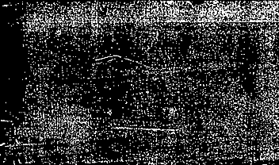

Blood & Medical Research

Slide 19
Components
Red Blood Cells (RCBs)
White Blood Cells (WBCs)
Platelets
Plasma
~45%
~1%
~1%
~55%

Slide 20
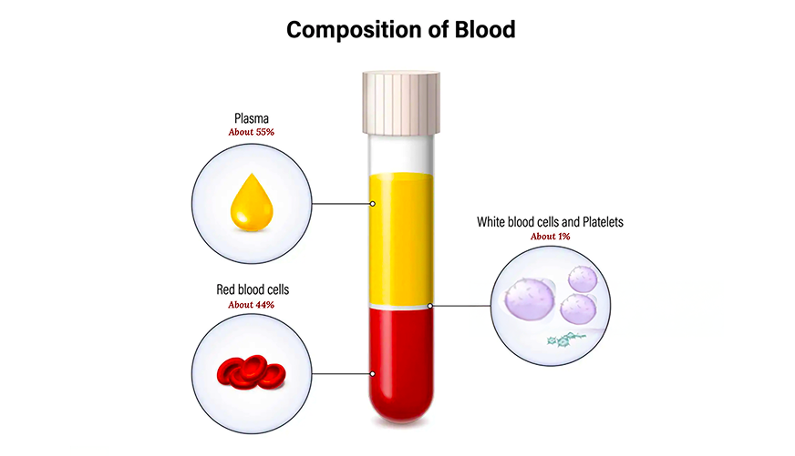

Slide 21
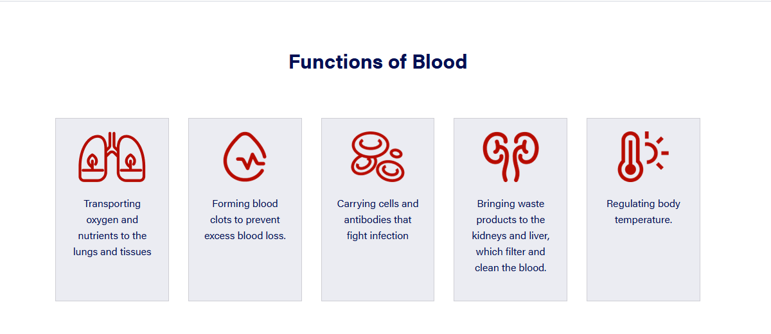

Slide 22
RBCs
Biconcave disk with flattened center, 7.5 micro m
Production of RBCs controlled by a protein er erythropoietin
Produced in bone marrow,
9 days to develop, lifespan of 120 days
No nucleus and can change shape
Broken in the spleen
Where does the red color come from?

Slide 23
WBCs
Not white, but colorless
Round and well defined membrane
Most common neutrophils
Lifespan < 1 day
Lymphocytes: T-cells and B-cells
Broken in the spleen
Where does the red color come from?

Slide 24
RBCs
Biconcave disk with flattened center, 7.5 micro m
Production of RBCs controlled by a protein er erythropoietin
Produced in bone marrow,
9 days to develop, lifespan of 120 days
No nucleus and can change shape
Broken in the spleen
Where does the red color come from?

Slide 25

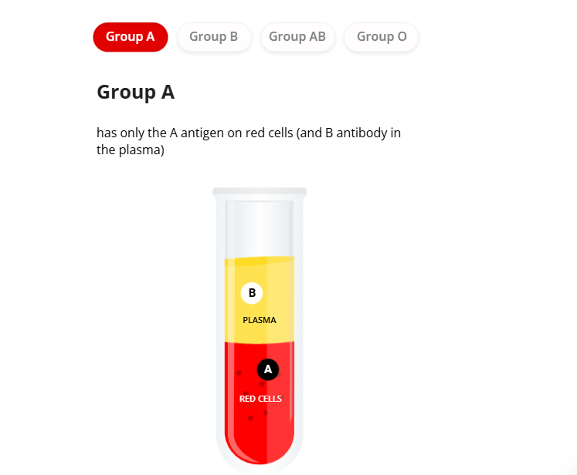
Blood Groups

Slide 26
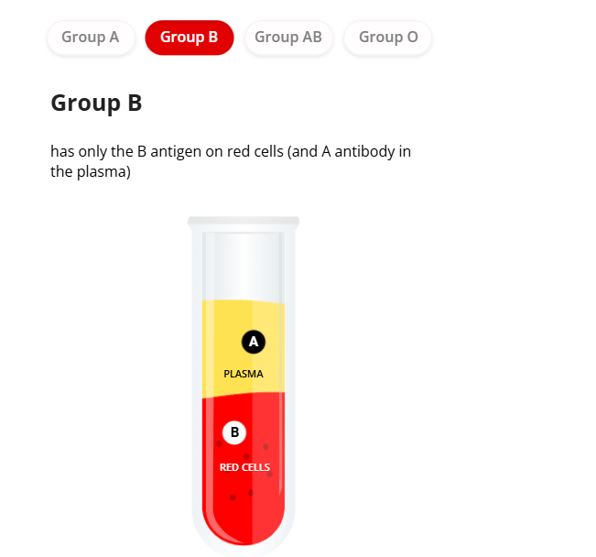
Blood Groups

Slide 27
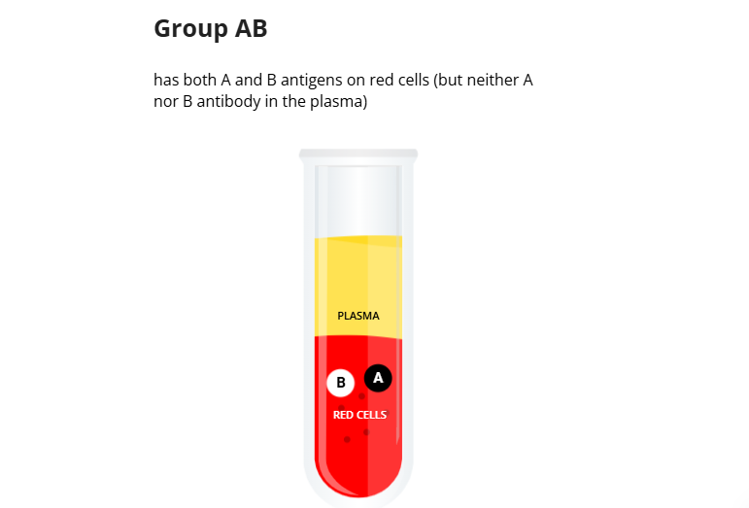
Blood Groups

Slide 28
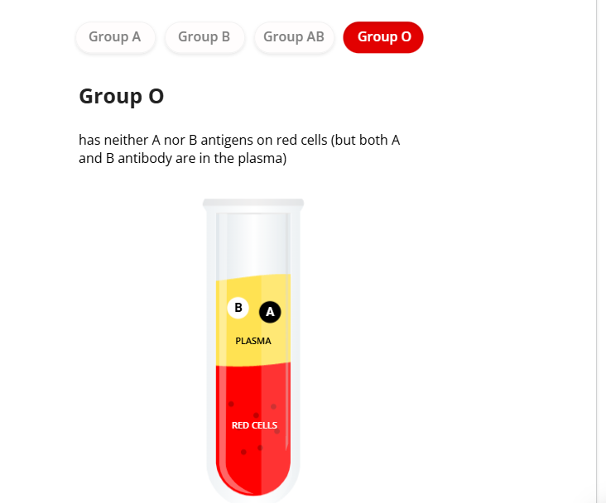
Blood Groups

Slide 29
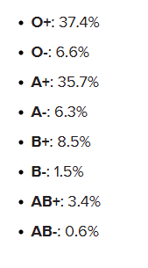
What determines your Exact Blood Type?

Slide 31
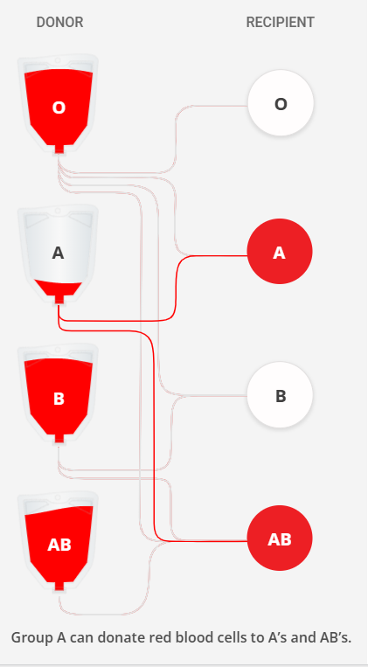
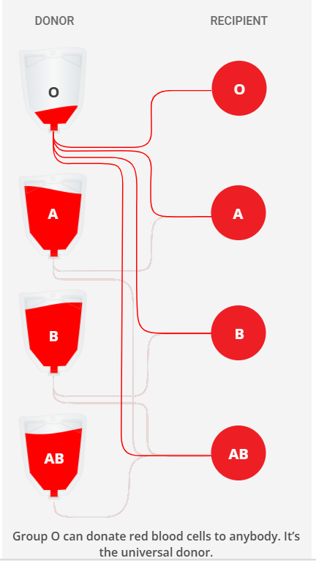
Notes:
Also, Rh-negative blood is given to Rh-negative patients, and Rh-positive or Rh-negative blood may be given to Rh-positive patients. The rules for plasma are the reverse.

Slide 32
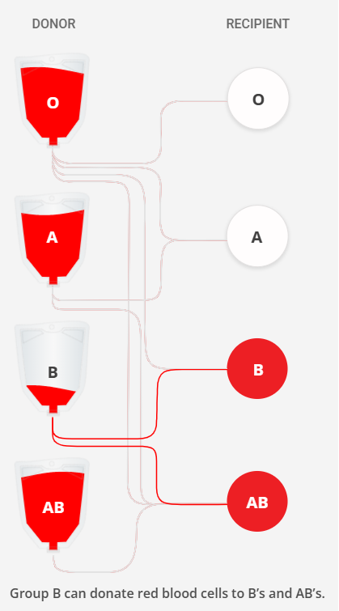
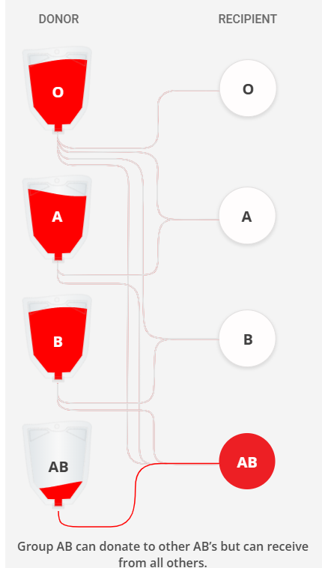
Notes:
O- : Donor
AB + : Recipeient

Slide 33
O negative
The Rarest Blood Type

Slide 34
How IS OUR Blood Type Determined?

Slide 35
